Slide 1
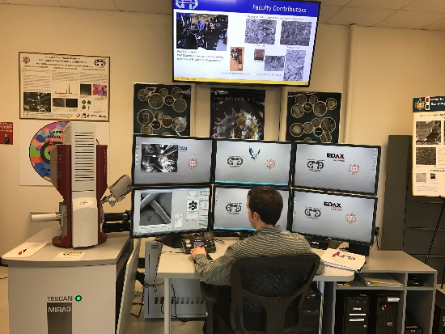
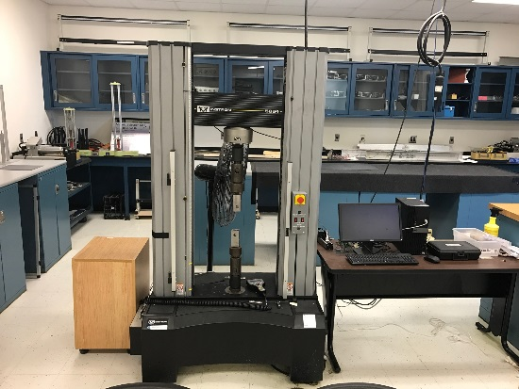
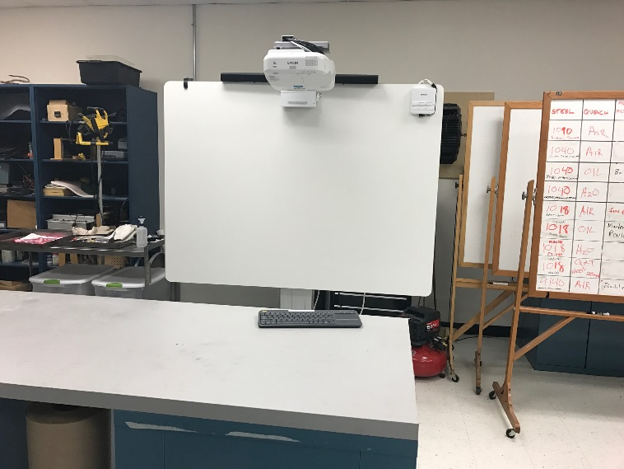
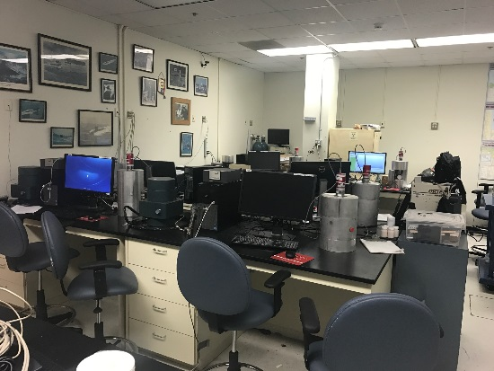
Bringing the Lab into the Classroom…
CTL Pop Up Friday – March 24, 2017
Using Epson Interactive Projector with a Laptop as a Mobile Lab Platform
CDR Brad Baker, PMP, Mechanical Engineering
Materials Faculty Lab Director
A $400k Scanning Electron Microscope system with a full suite of detectors.
One of several different mechanical loadframes.
Turning this….
Into this…
A nuclear engineering workstation with NaI, LaBr, and HPGe detectors.
All while completely ITSD compliant, safe, and secure

Slide 2
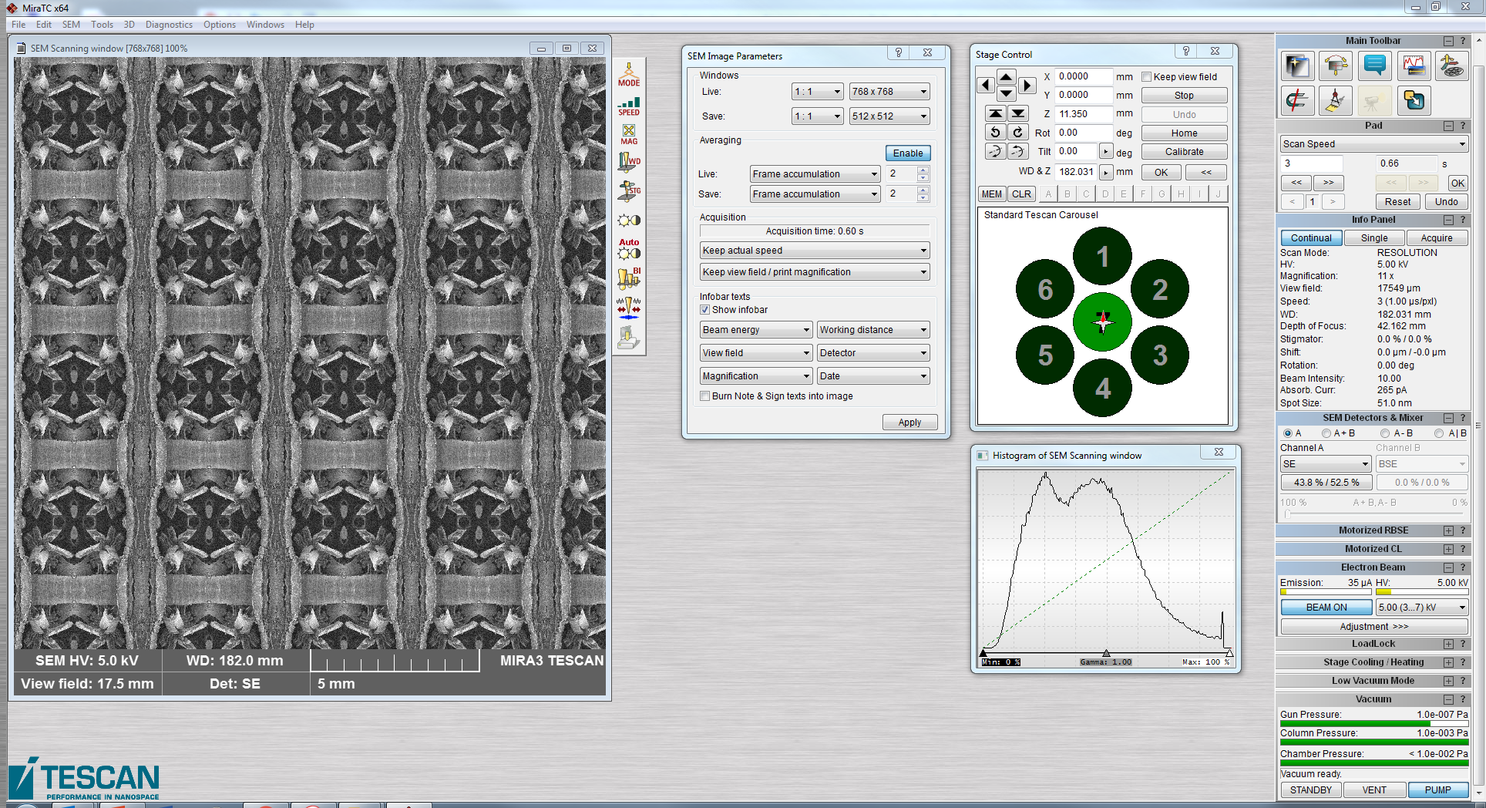
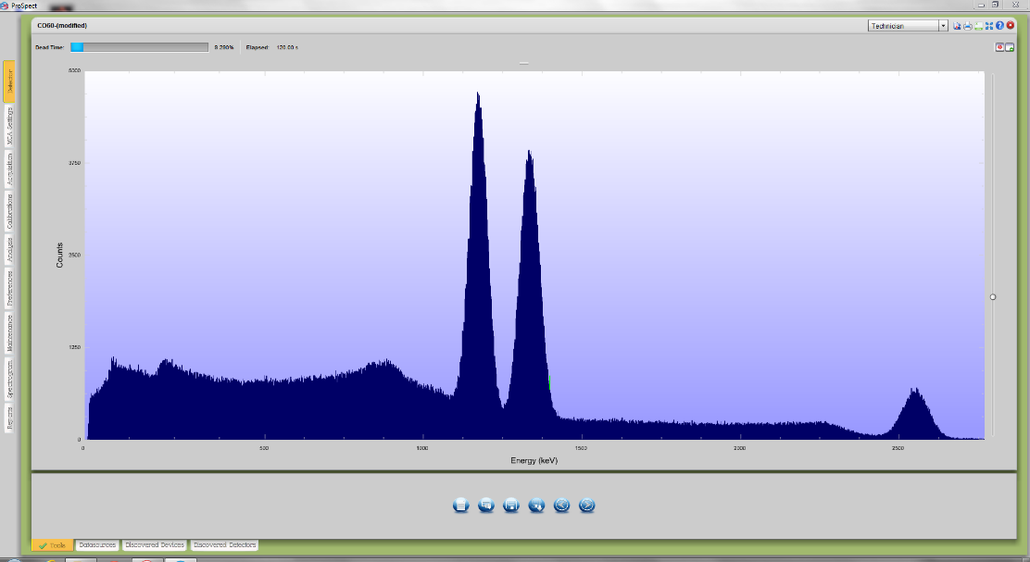
Bringing the Lab into the Classroom…
Up to 4 demonstrations:
Scanning Electron Microscope (Ri237A)
NaI Detector (Ri005)
Optical Microscope (Ri237A)
Mechanical Loadframe (Ri236)
Scanning window of the EME SEM. Full analysis can be done as long as a sample is preloaded.
Remarkably, there is little lag and the scan can be pretty clearly seen (this is not accidental).
In each case, full functionality of the lab equipment is available and data can be shown real time resulting in a fully interactive session.
Operations to collect data can be started, stopped, or paused with no impact on the process.
Energy spectrum of Co-60 analyzed using one of several NaI scintillation detectors.
Counting can be viewed remotely during the experiment (very useful for long experiments).

Slide 3
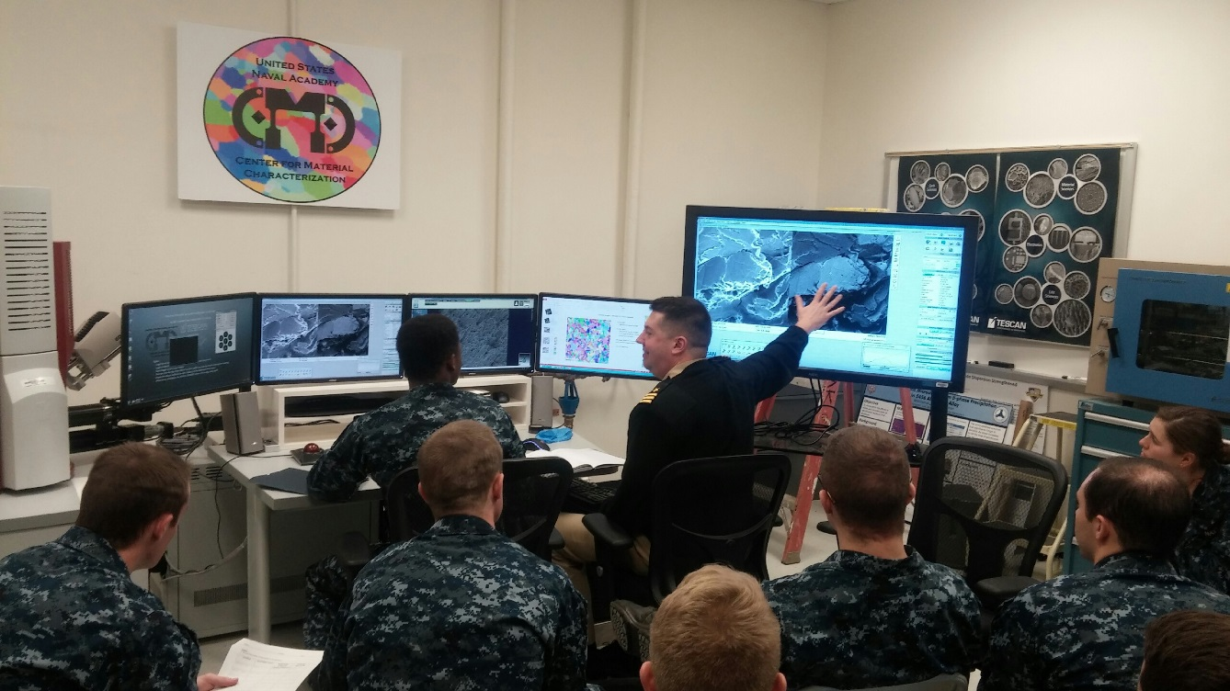
Possible Uses…
Advantages:
Laboratory elements are critical to some classes where students need experience operating equipment while in some other classes they provided as demonstrations with the instructor or technician performing the operation.
In either case, many labs are not well suited for large group discussion for a number of possible reasons:
Lab classrooms are often small and/or remote.
The equipment presents a hazard to the student (e.g. nuclear engineering courses).
There is insufficient time during a single period to go to and from the lab space.
The lab environment is not well suited for a balance of classroom and lab instruction.
Not all classes require the same level of lab support. In this case a large class that only uses a device once may not be well suited to go to the lab environment.
Instead the lab environment can be brought to the student in any class room on the Yard.

Slide 4
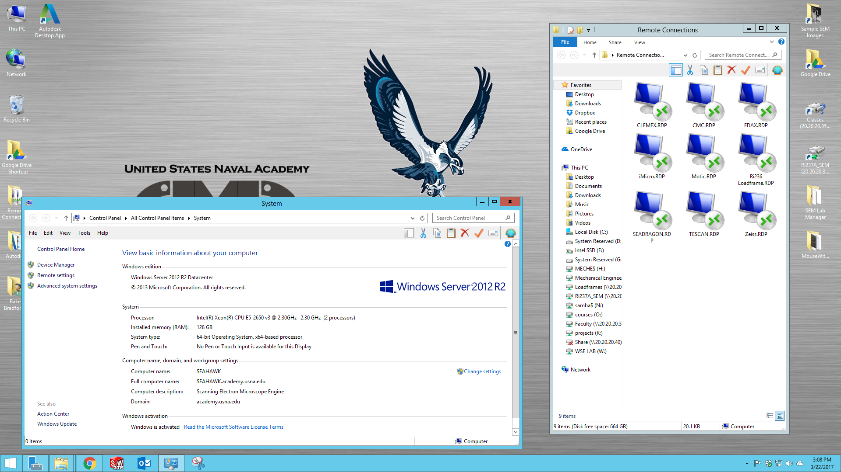
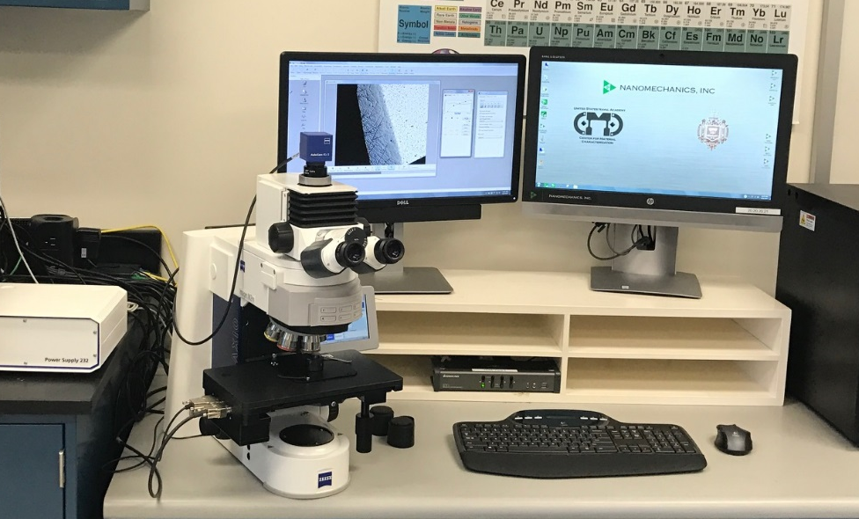
How is this all possible??
The are 4 major components that make this type of setup work:
A suitable projector (why you are here)
Lab equipment that is fully PC driven (i.e. minimal number of manual controls/functions)
A laboratory “engine” (e.g. SEAHAWK)
Infrastructure (do not lose sight of this obvious requirement)
All of the example shown today are made possible by lab engines SEAHAWK and SEADRAGON.
These are powerful PCs that bridge the gap.
There is a reason why this microscope is a $70k microscope vice a $20k microscope even though the optics might be the same.
Think about this as sourcing lab devices.
Any questions or ideas contact:
CDR Brad Baker
EME/ENR
bbaker@usna.edu

